Slide 1
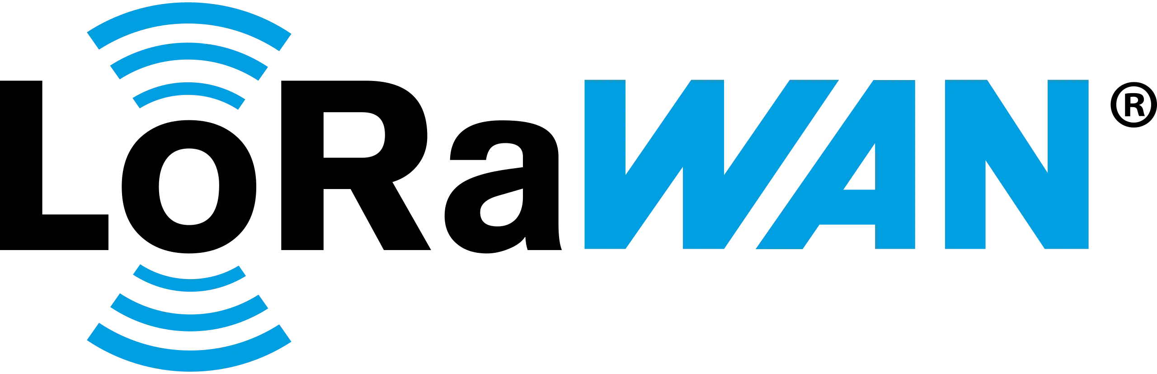
By Cyril Efren Fabro
https://www.ezurio.com/iot-devices/lorawan-iot-devices

Slide 2
Table of Contents
Definition
Main Components
Architecture
Design
Device Classes
Security
Applications
Advantages and Disadvantages
Companies that use LoRaWan

Slide 3
Definition

Slide 4
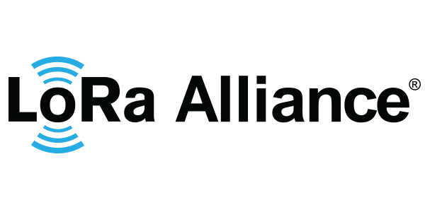
Definition (Cont.)
LoRaWAN stands for Long Range Wide Area Network.
Low-Power Wide-Area Network (LPWAN) communication protocol designed for Internet of Things (IoT) devices.
Enables devices to communicate over long distances while consuming little energy.
Suitable for small, occasional data transmissions, such as temperature readings, water-meter readings, and soil-moisture measurements.
Open standard maintained by the LoRa Alliance.
Important Distinction:
LoRa: Physical radio technology that transmits data wirelessly.
LoRaWAN: Communication protocol that manages devices, messages, network access, and security.
https://www.semtech.com/lora/ecosystem/lora-alliance

Slide 5
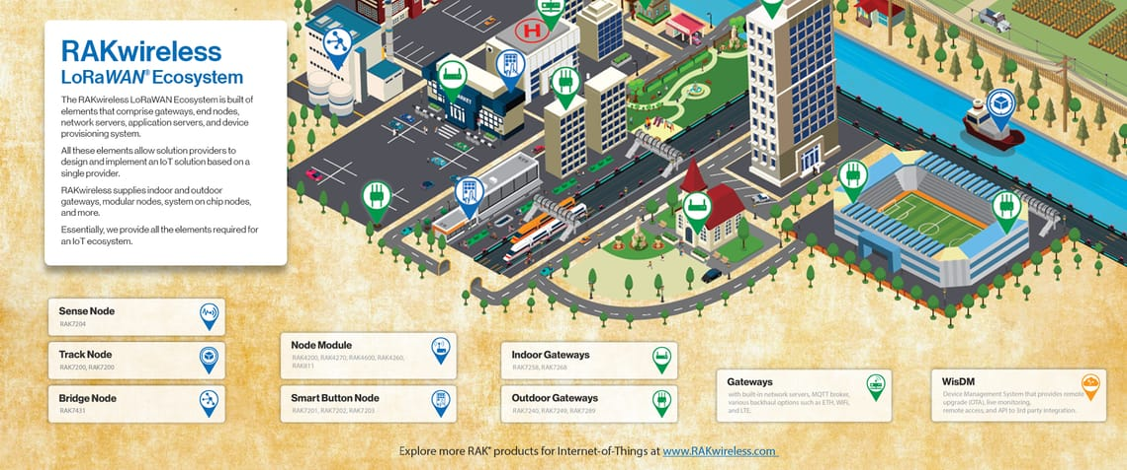
Definition (Cont.)
https://news.rakwireless.com/everything-you-need-to-know-about-lorawan/

Slide 6
Definition (Cont.)
Long-Range Communication
Low Power Consumption
Devices can communicate across large areas, including rural locations and buildings. Actual range depends on terrain, buildings, antenna placement, and interference.
Devices can spend most of their time in sleep mode, helping battery-powered sensors last for years under suitable operating conditions.
Security
Large-Scale Connectivity
LoRaWAN supports device authentication, message integrity, and AES-based encryption.
A gateway can receive messages from many devices, depending on coverage, traffic, radio settings, and network capacity.

Slide 7
Architecture

Slide 8
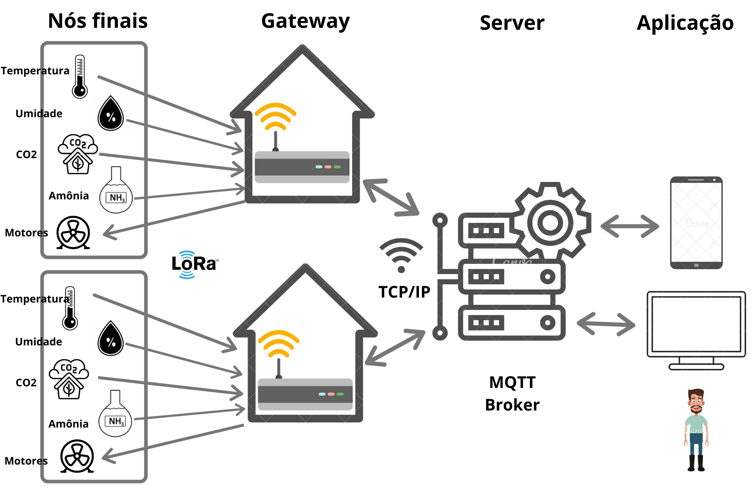
Architecture (Cont’)
End Devices
Collects Data and
Sends it
Gateways
Receives the end devices data and forwards it to network server
Network Server
Validates and
routes the
message
Application Server
Process/Forward Data
Application
Displays the data
https://www.thethingsnetwork.org/forum/t/lorawan-multi-end-devices/34778

Slide 9
Design

Slide 10
Design (Cont’)
Frequency bands: region-specific radio frequencies.
Modulation: Chirp Spread Spectrum (CSS) to transmit data and enable reception of relatively weak signals.
Spreading factors: Spreading Factors SF7–SF12. Higher spreading factors generally improve sensitivity and range but reduce data rate and increase airtime.
Adaptive Data Rate (ADR): Adjustable data rate and transmission power when conditions allow, improving efficiency.
Message types: Devices transmit uplink messages to the network.
Activation: Over-The-Air Activation (OTAA) allows a device to join the network and establish session keys. Why the design matters:
The radio settings determine the trade-off between range, airtime, energy use, and network capacity.

Slide 11
Device Classes

Slide 12
Table
Class | How it works | Best suited for | Example
Class A | Opens two short receive windows after each uplink transmission | Battery-powered sensors | Soil Sensor
Class B | Adds scheduled receive windows synchronised using network beacons | Devices needing more predictable downlink opportunities | Smart Street Lighting
Class C | Keeps its receiver open most of the time when not transmitting | Mains-powered actuators needing more responsive commands | Powered Controller
All LoRaWAN devices must support Class A.
Class A generally offers the lowest power consumption.
Class B allows more predictable opportunities to receive messages.
Class C offers the most frequent opportunities to receive messages but consumes more power.

Slide 13
Applications

Slide 14
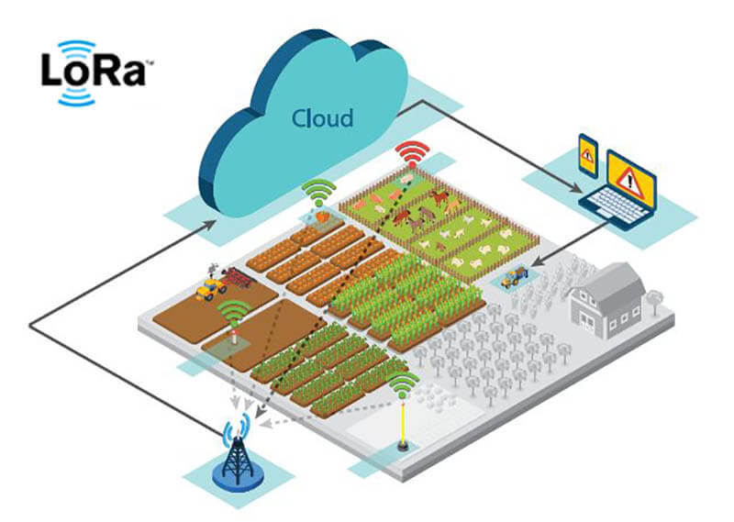
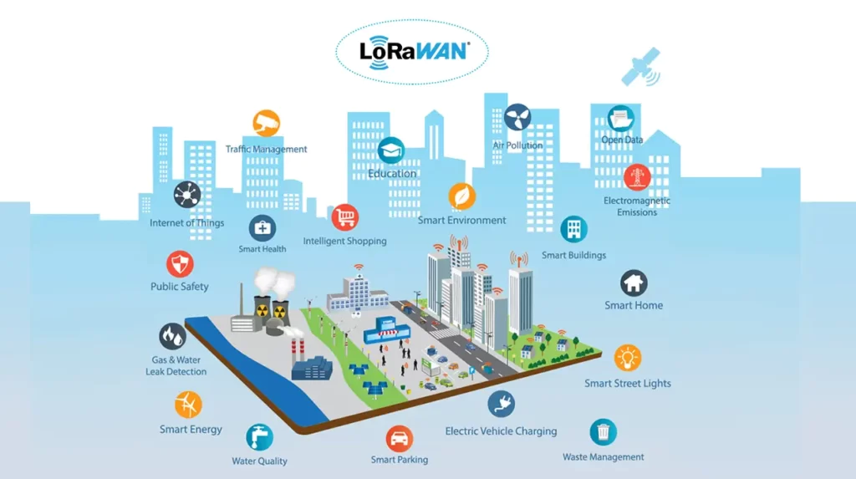
Applications (Cont’)
Agriculture
Smart Cities
Soil-moisture monitoring
Irrigation management
Greenhouse monitoring
Parking sensors
Waste-bin monitoring
Streetlight monitoring
https://www.richerlink.com/lora-smart-agriculture-solution/
https://www.mokolora.com/lorawan-in-smart-cities/

Slide 15
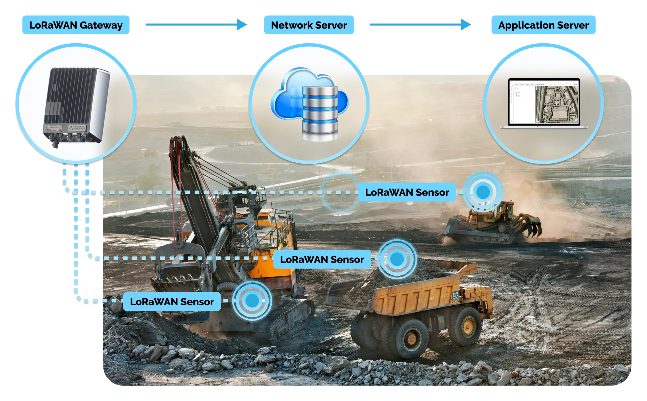
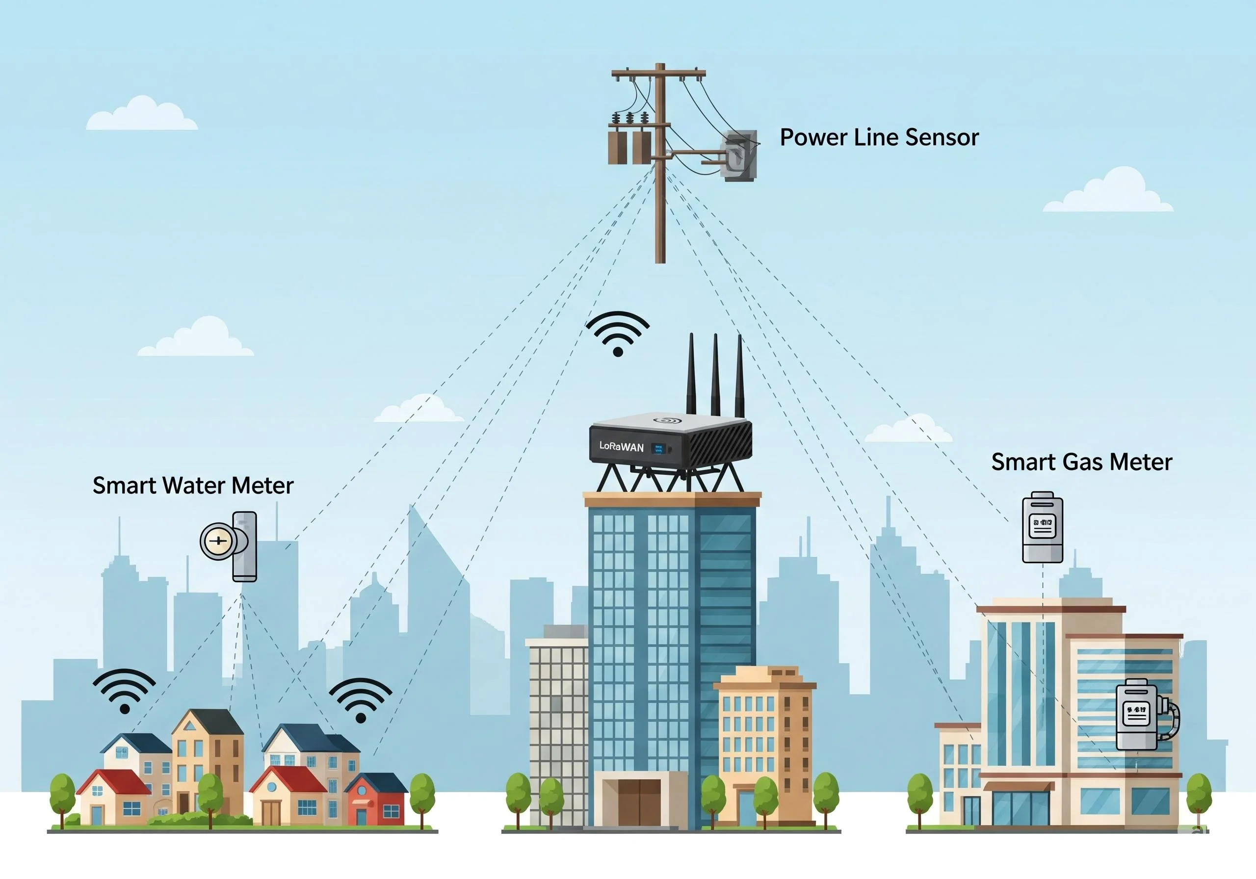
Applications (Cont’)
Industry
Utilities and Buildings
Equipment monitoring
Leak detection
Environmental sensing
Water-meter reading
Energy monitoring
Indoor air quality
https://tektelic.com/expertise/lorawan-for-mining-industry/
https://www.robustel.store/blogs/industrial-iot-blog/lorawan-for-smart-utilities-amr

Slide 16
Advantages and Disadvantages

Slide 17
Advantages and Disadvantages (Cont’)
Advantages
Disadvantages
Long communication range
Low energy consumption
Suitable for battery-powered devices
Supports large sensor deployments
Useful in remote locations
Standardized technology with multiple vendors
Security mechanisms built into the protocol
Low data rates compared with Wi-Fi
Unsuitable for video or large files
Limited opportunities for downlink messages
Higher spreading factors increase airtime
Buildings and interference can reduce coverage
Gateway coverage and capacity need planning
Regional frequency and radio regulations must be followed

Slide 18
Companies that use LoRaWan

Slide 19
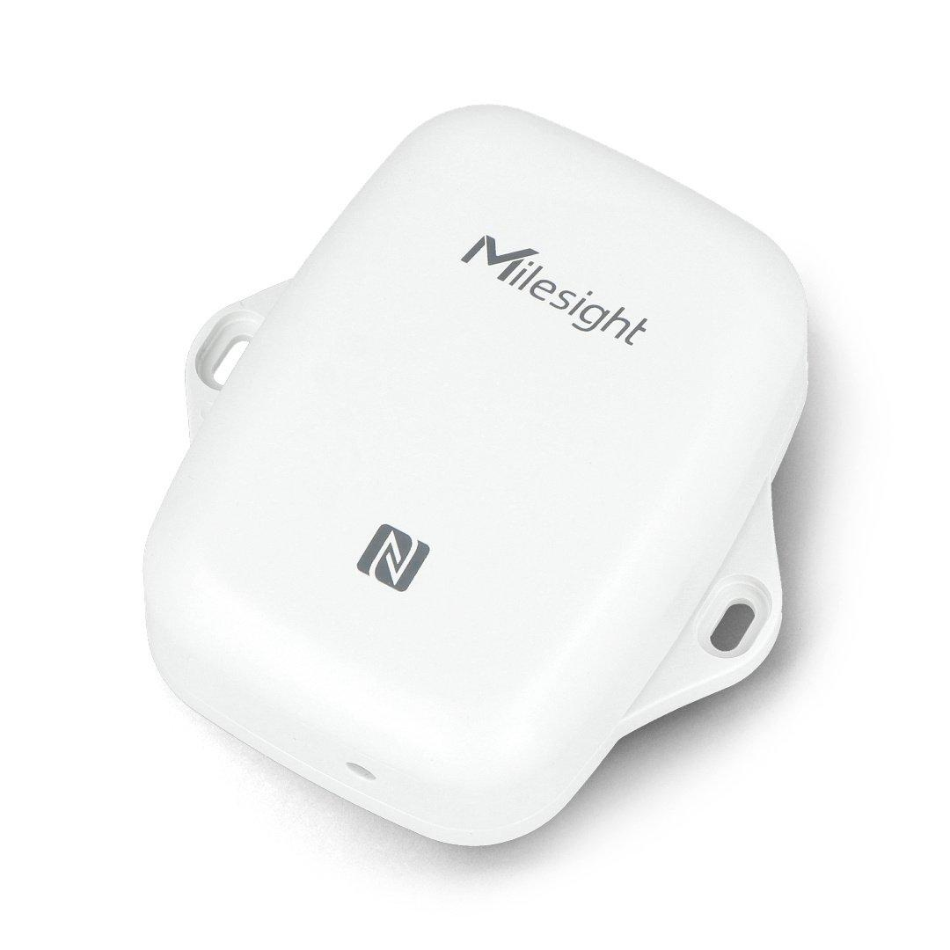
Companies that use LoRaWan (Cont’)
Milesight - EM300-TH
Measures temperature and relative humidity.
IP67-rated enclosure for demanding indoor and outdoor environments.
Supports LoRaWAN Class A and OTAA or ABP activation.
Stores historical readings and supports data retransmission.
Manufacturer-stated battery life can exceed 10 years under specified conditions.
Applications: Greenhouses, warehouses, and environmental monitoring.

Slide 20
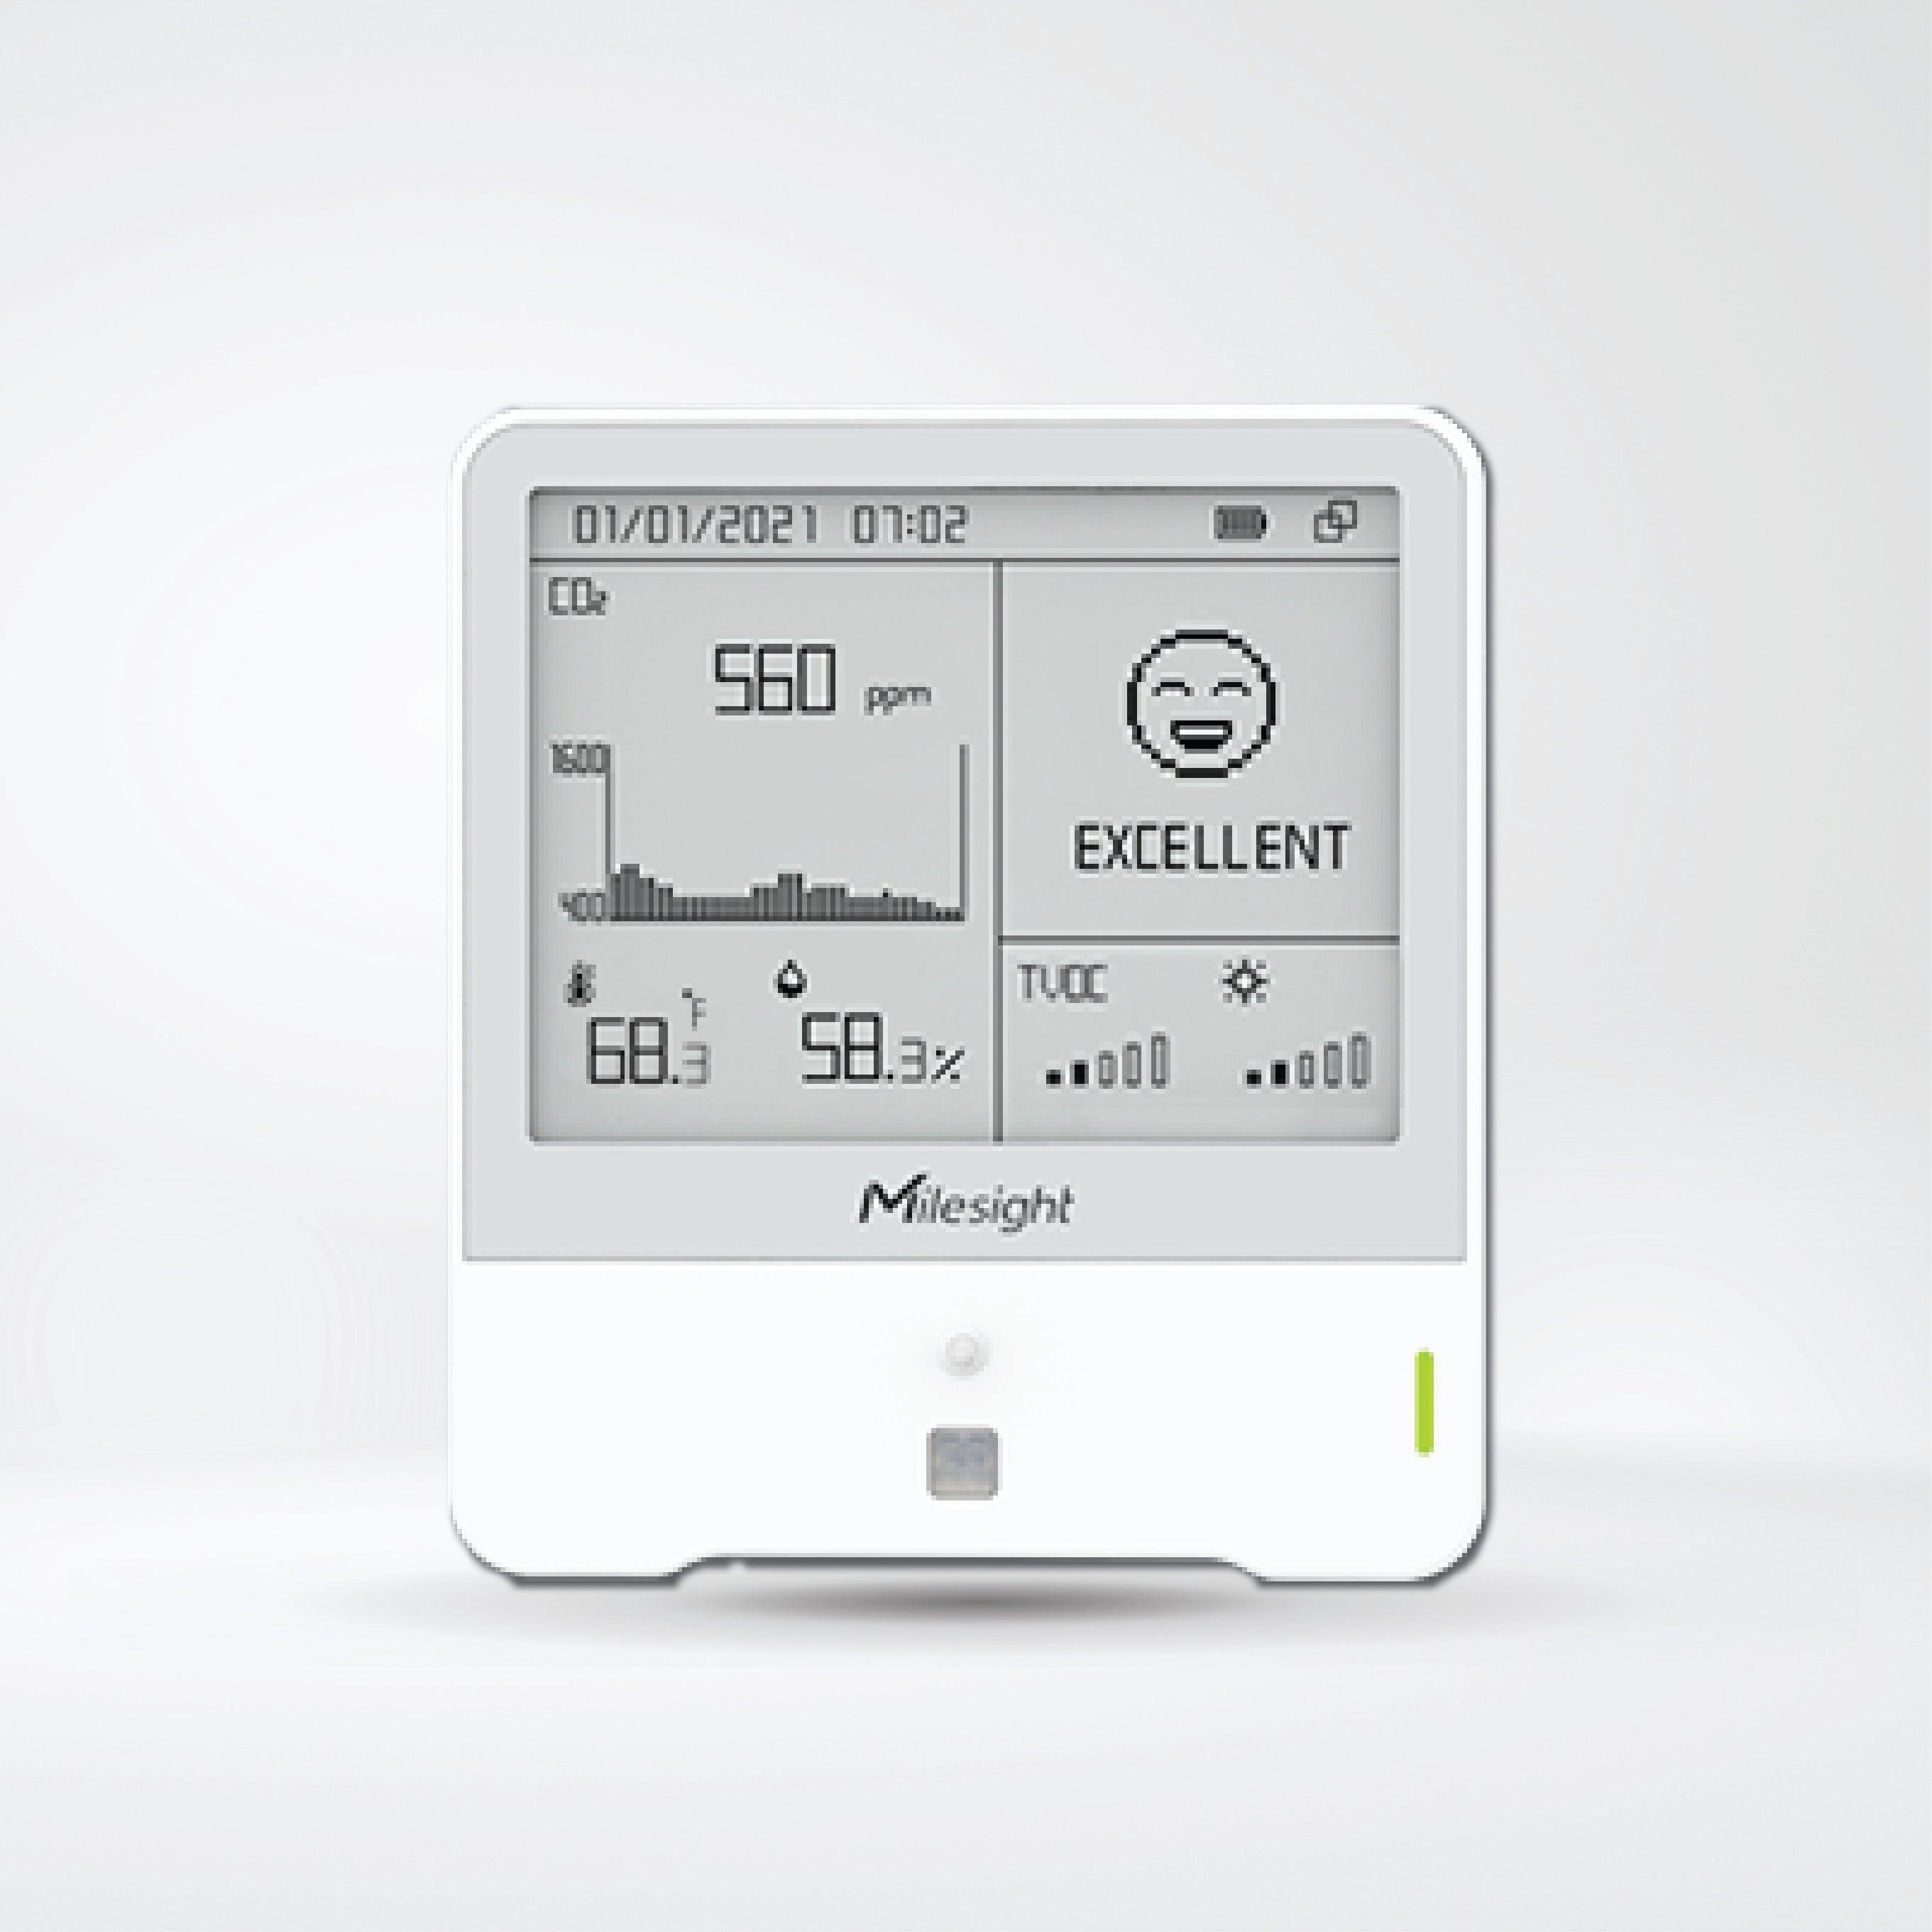
Companies that use LoRaWan (Cont’)
Milesight - AM300 Series
Different models measure combinations of temperature, humidity, CO₂, light, and motion.
Some models include an e-ink display.
Can store measurements and provide threshold alerts.
Sends sensor readings through LoRaWAN.
Applications: Schools, offices, and smart buildings.

Slide 21
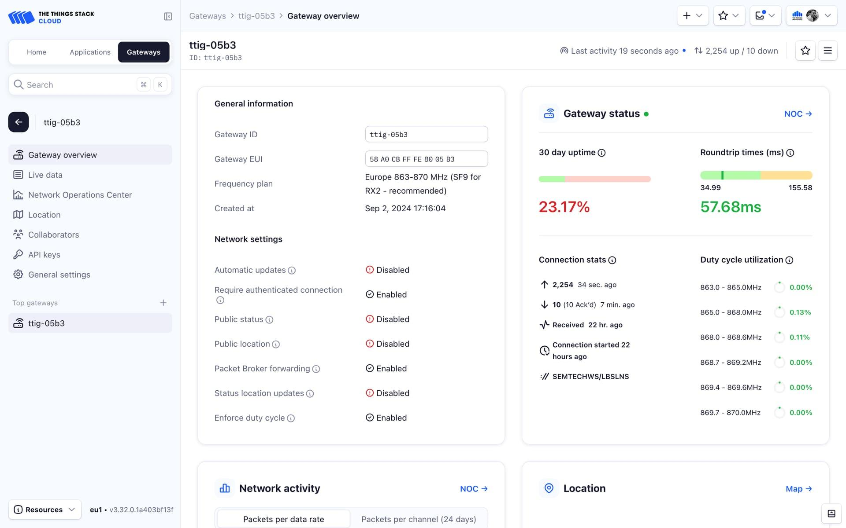
Companies that use LoRaWan (Cont’)
The Things Industries - The Things Stack
Connects and manages LoRaWAN devices and gateways.
Provides device onboarding and network monitoring.
Supports message routing and integrations through webhooks.
Offers cloud-hosted and self-managed deployment options.
Applications: Managing IoT networks and sending sensor data to dashboards or other software.

Slide 22
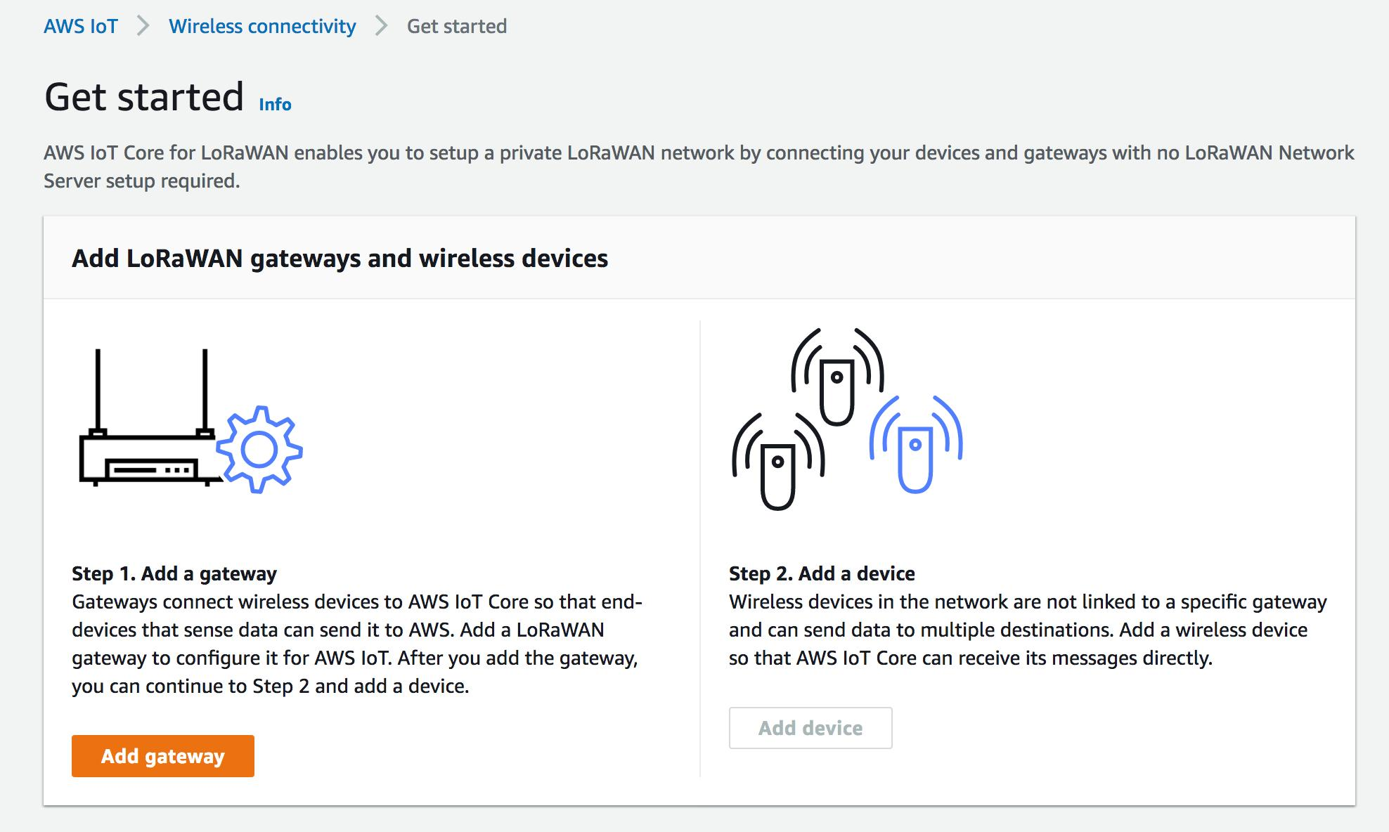
Companies that use LoRaWan (Cont’)
Amazon Web Services - AWS IoT Core for LoRaWAN
Connects compatible LoRaWAN devices and gateways to AWS.
Supports device and gateway onboarding.
Routes incoming messages to other AWS services.
Enables cloud-based processing, storage, and monitoring.
Applications: Cloud-connected environmental monitoring and industrial IoT.

Slide 23
Thank You !

Slide 24
Reference
The Things Network — LoRaWAN Fundamentals
The Things Network — Architecture
The Things Network — Device Classes
Milesight — EM300-TH Sensor
Milesight — AM300 Series Sensors
The Things Industries — The Things Stack Features
AWS — AWS IoT Core for LoRaWAN

